Slide 1
Gypsy, Roma and Traveller Migration
www.ourmigrationstory.org.uk

Slide 2
Gypsy, Roman and Traveller Migration
Lesson Objectives
Starter task
To know when and how Gypsy and Roma people came to Western Europe
To explore an early example of discrimination towards Gypsies in Britain
To investigate Gypsy, Roma and Traveller History Month and produce an assembly to raise awareness of it at your school
Discuss the terms above with the person next to you – what do you understand them to mean?
Remember to be respectful & factual – and don’t be afraid to say you do not know what they mean.
If you do not know what they mean, what questions do you have about these terms?
www.ourmigrationstory.org.uk
Notes:
Starter task: this will of course need much care when discussing the terms and so the task will need to be clearly introduced by the teacher. However, the lesson is also an opportunity to tackle prejudices and stereotypes, so the starter is an opportunity to flush some of those out – as long as this is done sensitively. See the lesson plan for tentative definitions.

Slide 3
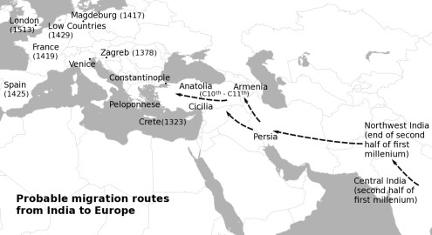
How did Gypsy, Roma and Traveller communities come to Britain?
https://www.youtube.com/watch?v=Q6wSLfGBVGY
Notes:
Introduce the history of Gypsy, Roma and Traveller communities through the YouTube clip. Use the map to re-cap the migration of Gypsy/Roma groups from India.

Slide 4
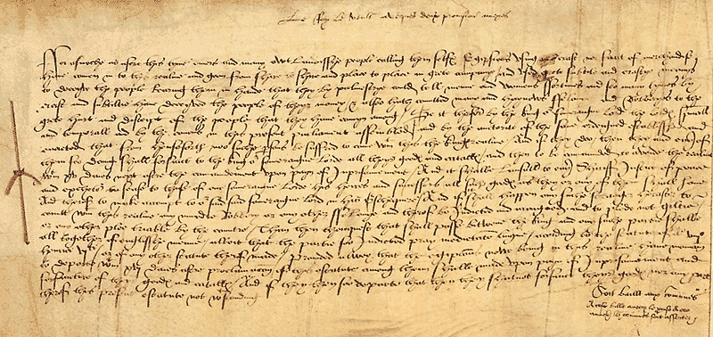
The Egyptians Act, 1530 (Courtesy of The National Archives)
The Egyptians Act 1530 was passed to expel people calling themselves ‘Egyptians’ (hence ‘gypsies’), and was not repealed until 1840.
“…a diverse and foreign people, calling themselves Egyptians, using no craft nor evidence of selling goods, who have come into this realm, and gone from shire to shire, and place to place, in great company; and used great subtlety and crafty means to deceive the people and persuading them that they, by palmistry, could tell men's and women's fortunes; and so, many times, by craft and subtlety, have deceived the people for their money; and also have committed many heinous felonies and robberies, to the great hurt and deceit of the people that they move among... the Egyptians who are now in this realm, have to depart within sixteen days.... and from now no Egyptians may enter the King's realm and if they do, then they with all their possessions, shall forfeit to the King our Sovereign Lord all their goods and titles and then must leave the realm within fifteen days under pain of imprisonment.”

Slide 5
The Egyptians Act, 1530 (Courtesy of The National Archives)
Questions:
List 3 things the ‘Egyptians’ are accused of doing that seem to have upset the authorities.
How many days did the ‘Egyptians’ have to leave England?
What would happen to any ‘Egyptians’ who came into the country after this law had been passed?
“…a diverse and foreign people, calling themselves Egyptians, using no craft nor evidence of selling goods, who have come into this realm, and gone from shire to shire, and place to place, in great company; and used great subtlety and crafty means to deceive the people and persuading them that they, by palmistry, could tell men's and women's fortunes; and so, many times, by craft and subtlety, have deceived the people for their money; and also have committed many heinous felonies and robberies, to the great hurt and deceit of the people that they move among... the Egyptians who are now in this realm, have to depart within sixteen days.... and from now no Egyptians may enter the King's realm and if they do, then they with all their possessions, shall forfeit to the King our Sovereign Lord all their goods and titles and then must leave the realm within fifteen days under pain of imprisonment.”

Slide 6
Gypsy, Roma and Traveller History Month – June each year
Your task is to research Gypsy, Roma and Traveller History Month (GRTHM) and to produce an assembly raising awareness of the event and GRT history in your school.
Your teacher will provide you with some useful links.
Your assembly could be structured as follows:
A first section introducing the audience to who Gypsy, Roma and Travellers are and briefly outlining their history in Britain
A section identifying some of the prejudices and discrimination faced by these communities – perhaps with some myths and truths included
A section on GRTHM and the kinds of events that take place

Slide 7
Useful links
http://grthm.natt.org.uk/whatis.php - What is GRTHM?
http://grthm.natt.org.uk/history-culture.php - history & culture
http://grthm.natt.org.uk/brief-history.php - brief history
http://grthm.natt.org.uk/timeline.php - timeline
http://grthm.natt.org.uk/myths-and-truths.php - myths and truths
http://www.grthmlondon.org.uk/2017/02/08/gypsy-roma-traveller-history-month-celebration-2017/ - Information about GRTHM 2017
http://www.grthmlondon.org.uk/grthm/promoting-gypsy-roma-traveller-history-month-in-your-school/ - ideas for publicising GRTHM in your school

